Slide 1

Emotion-Based Mental Health Assessment with Explainable AI (XAI)
Department of Computer Science and Engineering
Netaji Subhas University of Technology (NSUT)
NAME OF THE STUDENT AND ROLL NUMBER
SHASHANK KUMAR (2021UCS1710)
SAKSHAM RAJ(2021UCS1713)
Under the supervision OF
Dr. Anand Gupta

Slide 2
TABLE OF CONTENTS
Introduction
Motivation
Literature Survey
Problem Statement
Implementation
Results and Discussion
Conclusion

Slide 3
INTRODUCTION
Mental health is often overlooked until it reaches a critical stage, highlighting the need for proactive monitoring. This project leverages AI-driven Emotion Recognition to assess mental well-being through facial expressions, voice tone, and text sentiment. Traditional AI models lack transparency, making predictions hard to trust, but by integrating Explainable AI (XAI) techniques like SHAP, LIME, and Grad-CAM, this system ensures interpretability. The goal is to develop a real-time, multimodal AI tool that provides accurate, transparent mental health assessments, enabling timely intervention for individuals and professionals.

Slide 4
MOTIVATION
Mental health disorders like depression and anxiety are rising globally, demanding scalable and objective assessment methods. Traditional diagnostics rely on subjective self-reports and therapist observations, often influenced by bias and stigma. AI-powered emotion recognition can enhance mental health monitoring by analyzing facial expressions, voice tone, and text sentiment for early detection and personalized intervention. However, AI’s lack of transparency limits trust in healthcare applications. This project integrates Explainable AI (XAI) techniques like SHAP, LIME, and Grad-CAM to ensure interpretable, reliable, and real-time mental health assessments, making AI-driven insights more accessible and trustworthy.

Slide 5
PROBLEM STATEMENT
1) Limitations of Traditional Assessments – Self-reported surveys and clinical evaluations are subjective, time-consuming, and inaccessible for many individuals.
2) Lack of Real-Time Monitoring – Existing mental health assessments do not provide continuous tracking, leading to delayed interventions.
3) AI-Based Emotion Recognition Potential – AI can detect emotional distress using facial expressions, voice tone, and text sentiment, but lacks explainability.

Slide 6
4)Trust Issues with AI Models – Black-box AI models lack interpretability, making it difficult for clinicians and users to trust AI-driven assessments.
5) Challenges in AI-Based Emotion Analysis – Issues like accent variability, background noise, and false positives affect the reliability of emotion detection.
6)Need for a Transparent & Accurate AI System – A multimodal AI system integrating XAI techniques (SHAP, LIME, Grad-CAM) can enhance trust, accuracy, and explainability.

Slide 7
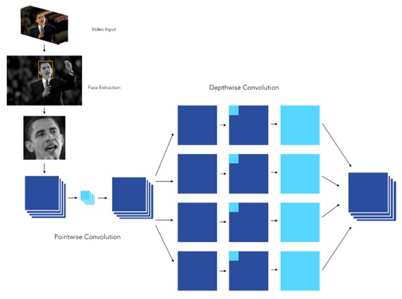
IMPLEMENTATION
Facial Expression Recognition Model
Input: Real-time facial images from webcam/video
Preprocessing: Frame extraction, grayscale conversion, normalization
Model: CNN (e.g., VGGNet or ResNet) trained on datasets like FER2013 or CK+
Output: Emotion labels (happy, sad, angry, etc.)
Notes: Focus on key facial regions (eyes, mouth) for expression detection

Slide 8
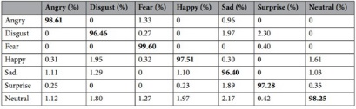
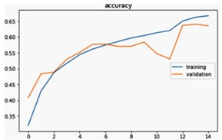
Fig. 1 confusion matrix
Fig .2 Accuracy across epochs

Slide 9
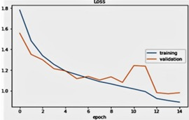
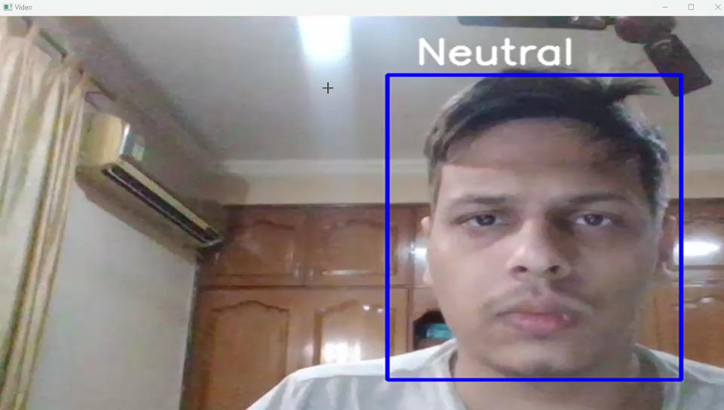
Fig. 3 loss across epoch
Example

Slide 10
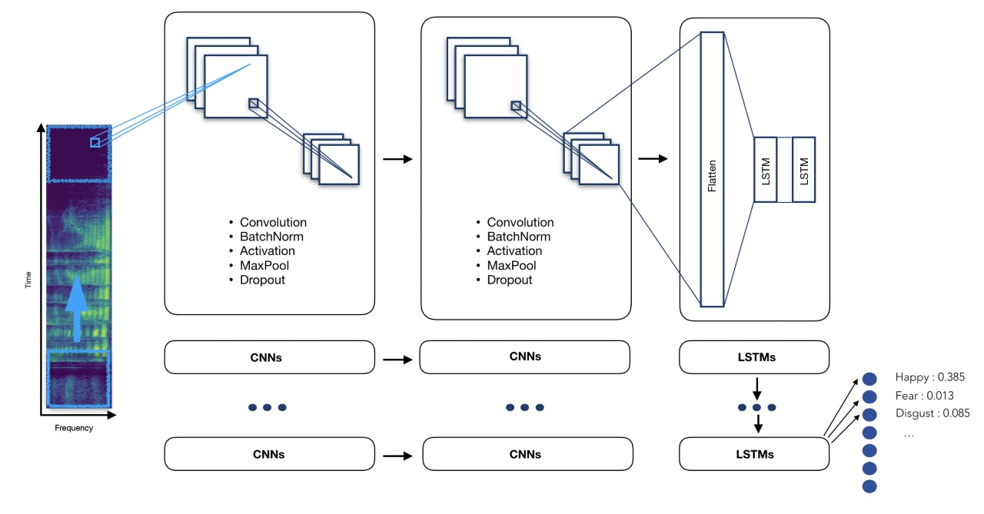
Voice Tone Recognition Model
Input Acquisition:-
Real-time audio is captured via a microphone, focusing on non-verbal cues such as tone, pitch, intensity, and rhythm.
Preprocessing:-
Noise reduction techniques are applied, and features like MFCCs, chroma, spectral centroid, and zero-crossing rate are extracted to represent emotional characteristics in speech.
Model Architecture:-
A Recurrent Neural Network (RNN) or Long Short-Term Memory (LSTM) model is used to capture temporal patterns in voice data, making it effective for identifying emotional tone variations.
Training Dataset:-
Emotionally labeled speech datasets such as RAVDESS and CREMA-D are used for training, covering a range of emotions.
Output:-
The model predicts emotional states like happiness, sadness, anger, and fear based solely on voice tone, independent of spoken content.

Slide 11
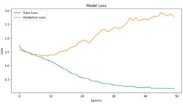
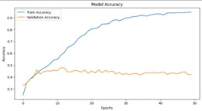
Fig.5 loss across epochs
Fig 6 accuracy across epochs

Slide 12
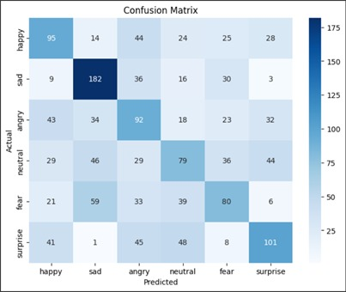
Confusion matrix

Slide 13
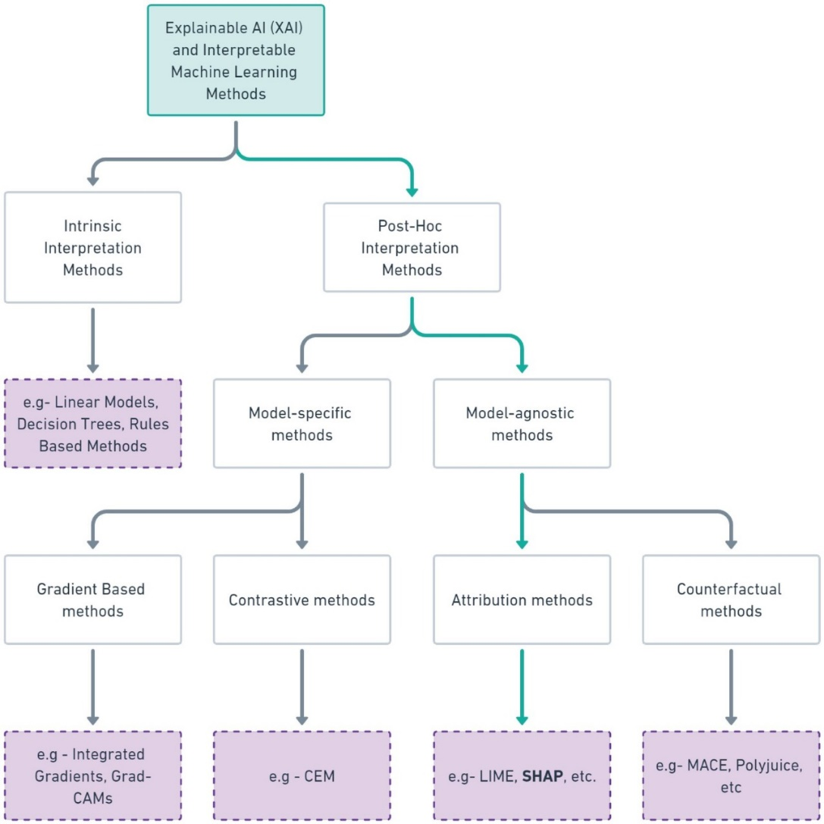
XAI (Explainable AI )
Why XAI?
Traditional deep learning models often function as black boxes, offering accurate predictions but lacking transparency. In sensitive domains like mental health, this lack of interpretability can hinder trust and adoption. Explainable AI (XAI) addresses this by making AI decisions understandable and transparent to users and professionals.

Slide 14
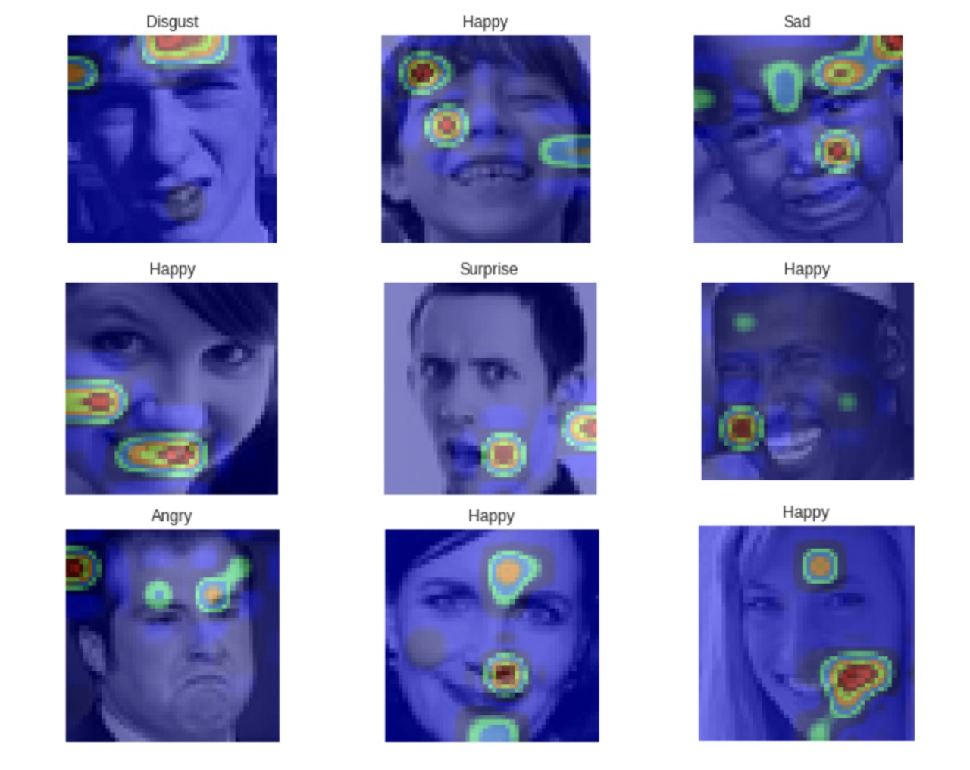
Techniques Used
Grad-CAM: Used with CNN-based facial models to generate heatmaps that highlight facial regions (e.g., smile lines, eyes) influencing emotion prediction..
SHAP: Delivers both global and local explanations by assigning importance scores to voice features like pitch and energy.
Heatmap for Grad Cam
heatmap = make_gradcam_heatmap(model, img_array, last_conv_layer_name, pred_label)

Slide 15
Future work
To address current limitations and expand the scope and clinical relevance of this research, the following future directions are proposed:
Incorporate Additional Modalities
Incorporate Treatment Plans
Real-Time, Continuous Monitoring
User-Centric XAI Interfaces
Deploy in Mobile and Web Applications

Slide 16
CONCLUSION
Today, more people are being diagnosed with mental health conditions—not necessarily because these issues are more common, but because society is finally becoming more open to acknowledging and addressing them. Our generation is breaking the stigma, and through this project, we aim to do our part.
By developing a transparent, AI-driven system for emotion-based mental health assessment, we hope to empower individuals to better understand their emotional well-being and take action early—because mental health deserves the same attention as physical health.

Slide 17
Thank you

